Slide 1
Timer 2
Used as 8 bit timer.
Not used as a counter.

Slide 2
Timer 2
Timer 2 CONtrol register – T2CON
Timer 2 register – TMR2
Period Register – PR2
Peripheral Interface Request register 1 – PIR1
Peripheral Interrupt Enable register 1 – PIE1

Slide 3
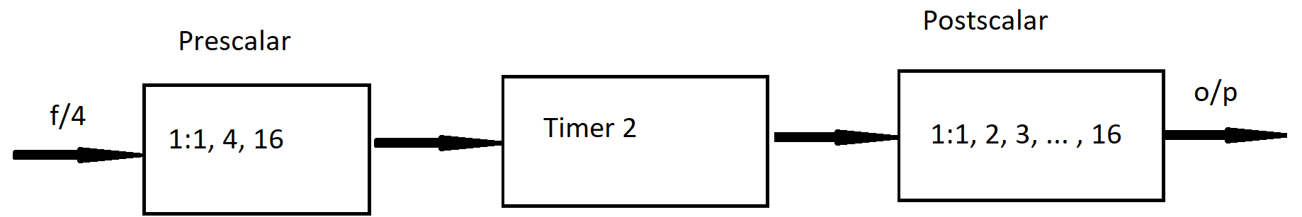

Slide 4
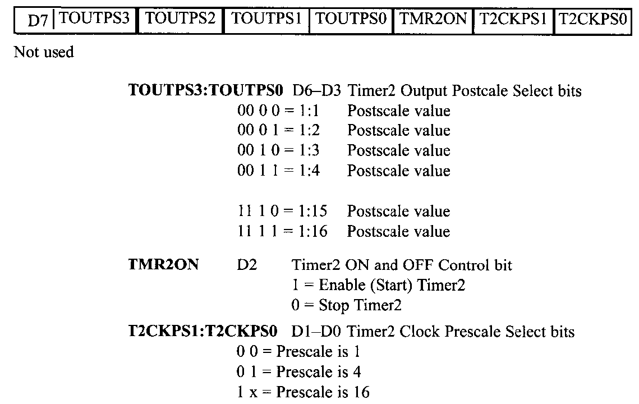
T2CON

Slide 5
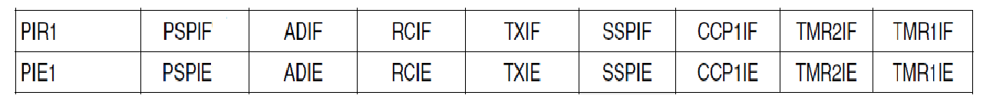
PIR1 and PIE1 registers
Peripheral Interrupt Request 1 register
TMR2IF → Timer 2 Interrupt Flag
Peripheral Interrupt Enable 1 register
TMR2IE → Timer 2 Interrupt Enable

Slide 6
Working of Timer 2
A fixed value is stored in register PR2
Initial value in TMR2 is 0.
Once Timer 2 is enabled, TMR2 register is incremented
When the value in TMR2 matches with the value in PR2 TMR2IF is set and TMR2 is reset.

Slide 7
Assuming that XTAL=10MHz, what is the frequency of the square wave at PORTB.4?

Slide 8
BCF TRISB,4
BCF PORTB, 4
MOVLW 0
MOVWF T2CON
MOVWF TMR2
MOVLW D’100’
MOVWF PR2
BCF PIR1, TMR2IF
BSF T2CON, TMR2ON
XYZ BTFSS PIR1, TMR2IF
BRA XYZ
BSF PORTB, 4
BCF T2CON,TMR2ON
END

Slide 9
BCF TRISB,4
BCF PORTB, 4
MOVLW 0
MOVWF T2CON
MOVWF TMR2
MOVLW D’100’
MOVWF PR2
BCF PIR1, TMR2IF
BSF T2CON, TMR2ON
XYZ BTFSS PIR1, TMR2IF
BRA XYZ
BSF PORTB, 4
BCF T2CON,TMR2ON
END
➔ T2CON =0 , no postscalar and no prescalar
Microcontroller frequency = 10/4 = 2.5MHz
Clock period = 1/2.5 =0.4µs
TMR2 increments from 0 to 100
Thus count =100
Half cycle delay=100*0.4 = 40 µs
Full cycle delay = 80 µs
Frequency of square wave = 1/80 = 12500 Hz

Slide 10
Assuming that XTAL=10MHz, what is the delay generated at PORTB.4?

Slide 11
BCF TRISB,4
BCF PORTB, 4
MOVLW 0X7B
MOVWF T2CON
MOVWF TMR2
MOVLW 0XFF
MOVWF PR2
BCF PIR1, TMR2IF
BSF T2CON, TMR2ON
XYZ BTFSS PIR1, TMR2IF
BRA XYZ
BSF PORTB, 4
BCF T2CON,TMR2ON
END

Slide 12
BCF TRISB,4
BCF PORTB, 4
MOVLW 0X7B
MOVWF T2CON
MOVWF TMR2
MOVLW 0XFF
MOVWF PR2
BCF PIR1, TMR2IF
BSF T2CON, TMR2ON
XYZ BTFSS PIR1, TMR2IF
BRA XYZ
BSF PORTB, 4
BCF T2CON,TMR2ON
END
➔ T2CON =7BH , 1:16 postscalar and 1:16 prescalar

Slide 13
BCF TRISB,4
BCF PORTB, 4
MOVLW 0X7B
MOVWF T2CON
MOVWF TMR2
MOVLW 0XFF
MOVWF PR2
BCF PIR1, TMR2IF
BSF T2CON, TMR2ON
XYZ BTFSS PIR1, TMR2IF
BRA XYZ
BSF PORTB, 4
BCF T2CON,TMR2ON
END
➔ T2CON =7BH , 1:16 postscalar and 1:16 prescalar
Microcontroller frequency = 10/4 = 2.5MHz
Frequency due to prescalar = 2.5/16 = 156250Hz
Clock period = 1/156250 =6.4 µs
TMR2 increments from 0 to 255
Thus count =255
Half cycle delay=255*6.4 =1632 µs
Full cycle delay = 3264 µs
Timer 2

Slide 14
BCF TRISB,4
BCF PORTB, 4
MOVLW 0X7B
MOVWF T2CON
MOVWF TMR2
MOVLW 0XFF
MOVWF PR2
BCF PIR1, TMR2IF
BSF T2CON, TMR2ON
XYZ BTFSS PIR1, TMR2IF
BRA XYZ
BSF PORTB, 4
BCF T2CON,TMR2ON
END
➔ T2CON =7BH , 1:16 postscalar and 1:16 prescalar
Microcontroller frequency = 10/4 = 2.5MHz
Frequency due to prescalar = 2.5/16 = 156250Hz
Clock period = 1/156250 =6.4 µs
TMR2 increments from 0 to 255
Thus count =255
Half cycle delay =255*6.4 =1632 µs
Full cycle delay = 3264 µs
Frequency of square wave = 1/3264 = 306.37 Hz
Frequency due to postscalar = 306.37/16 = 19.148Hz
Full cycle delay at PORTB.4 = 52.224 ms
Half cycle delay at PORTB.4 = 26.112 ms
Timer 2

Slide 15
BCF TRISB,4
BCF PORTB, 4
MOVLW 0X7B
MOVWF T2CON
MOVWF TMR2
MOVLW 0XFF
MOVWF PR2
BCF PIR1, TMR2IF
BSF T2CON, TMR2ON
XYZ BTFSS PIR1, TMR2IF
BRA XYZ
BSF PORTB, 4
BCF T2CON,TMR2ON
END
➔ T2CON =7BH , 1:16 postscalar and 1:16 prescalar
Microcontroller frequency = 10/4 = 2.5MHz
Frequency due to prescalar and postscalar = 2.5/(16*16) = 97,656.25Hz
Clock period = 1/97,656.25 =10.24 µs
TMR2 increments from 0 to 255
Thus count =255
Half cycle delay=255*10.24 =26.112 µs

